Slide 1
GROUP 22
Lovely Digra IIT2017090
Abhishek Vishwakarma IIT2017091
Anuj Raj IIT2017092

Slide 2
Problem Statement
Our required aim is to design and analyse aglorithm for single digit multiplication without using multiplication, division or modulo operator and use this application to multiply two positive integers.

Slide 3
Introduction
Now the question arises how to perform single digit multi-
plication without using an *?
For this, a 1-D Look-up table is created to get the result by
the multiplication of two single digit numbers.
Now what is a look-up table?
A Look-Up table is an array that replaces run time com-
putation with a simpler array indexing operation. It can be
2D,3D, single input single output, multi input multi output.

Slide 4
Algorithm
Simple(Naive) Approach :
> Firstly, store the product of all single digit numbers in 1-D look-Up Table.
> To calculate product of any two no’s multiply each digit of multiplier with multiplicant.
> Product of any two single digit no. a and b can be found in the look-up table in location ”9*(a-1)+(b-1)” by using repeated addition.
> Store the intermediate result of product of num1 with each digit of num2 in a 2-D Matrix, like the way a primary school students does .
> Finally add the intermediate results in column fashion to
get the final result.

Slide 5
Algorithm
Optimisation :
> Instead of storing intermediate values in 2-D matrix concatenate the result into a string and parse it to get the intermediate result.
> Now addition becomes very simple . Just add it to the variable storing the final result.
> Repeat the process for every digit of num2 to get the final result.

Slide 6
Pseudo Code
procedure mul(inta)
for all i = 1 to a do
//a times repeated addn of c where is 9
return c
procedure multiply(inta, intb)
return look-Up[mul(a − 1)+(b − 1)]
number1 ← input
number2 ← input
num1String ← parsed num1 to string
num2String ← parsed num2 to string

Slide 7
reverse(num1Str)
reverse(num2Str)
for all i = 1 to no of digits num1 do
carry ← 0
for all j = 1 to no of digits num2 do
product ← multiply(num1Str[i], num2Str[j])
product ← product + carry
result ← unit place of product
carry ← tens place of product
intermediate result ← concatenate(result)
procedure reverse(intermediate r esult)
finalResult ← f inalResult + intermediateRes
print(f inalResult)

Slide 8
Experimental Analysis
For the experimental analysis of this algorithm, we will take same value for both num1 and num2 for easy calculations and iterate a loop for assigning num1 and num2 with the loop variable.
And for every single digit pair of the multiplicant and the multiplier we need to access product from the look-Up table at max 9 iterations in the repeated addition loop of mul(9) for function and 0 iterations for mul(0).

Slide 9
The Best Case
As time complexity depends on the number of digits of multiplier, number of digits in the multiplicant and value of the single
digit of each pair of the two integers.So the Best Case is when each single digit pair contains atleast one 0 with growth rate
Ω(1 ∗ d ∗ d) where d is the total digits in the given integer.

Slide 10
The Worst Case
Worst Case arises if each single digit pair of multiplicant and multiplier integers is 9 as in this case we need to access product from the look-Up table at
max 9 iterations in the repeated addition loop of mul(9) for the function.
The growth rate for the worst case will be bounded by
O(9 ∗ d ∗ d)
Where d is the total digits in the given integer.

Slide 11
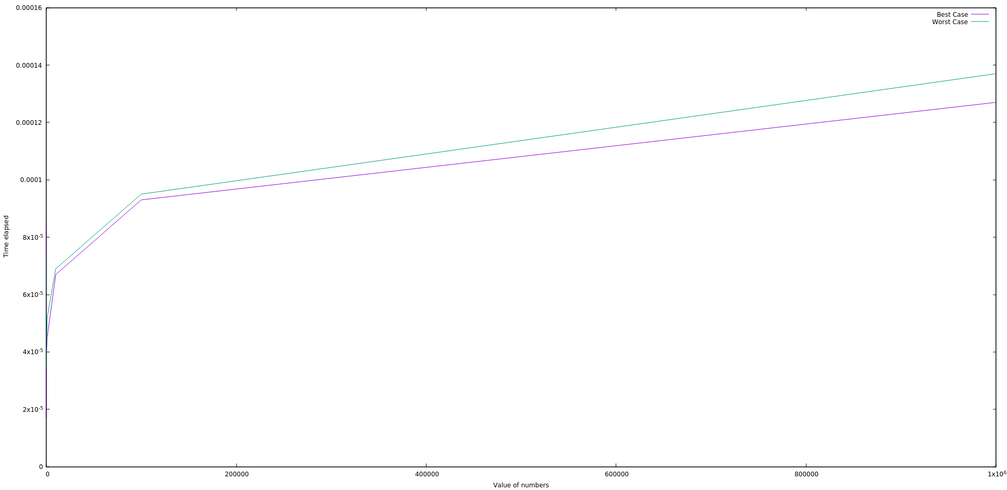
The Graph
Value of Number vs Time elapsed

Slide 12
Conclusion
The Algorithm is correct and optimal under the constraints defined in the Problem Statement.

Slide 13
Thank You!

